Slide 1

Speech Synthesis for the Chuvash Language
Dante Razo
Department of Linguistics at
Indiana University Bloomington

Slide 2
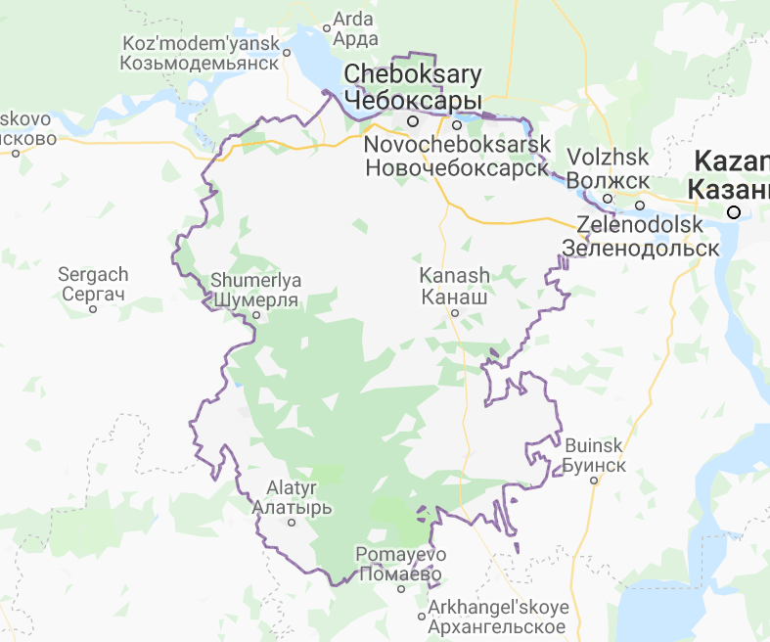
Background
Chuvash (Чӑвашла) is a minority language spoken by roughly one million people in European Russia
Turkic language that utilizes the Cyrillic alphabet
This project aimed to train popular speech-synthesis systems and compare them
Notes:
You might remember Chuvash from our practicals…

Slide 3
Introduction to Speech Synthesis
Speech synthesis is the production of artificial human speech
e.g. Bloomington Transit & IU buses, Google Assistant, Amazon Alexa
Text-to-speech (TTS) is a subset of speech synthesis
Self-explanatory name
Take text, parse it, conduct linguistic analysis on it, then produce audio waveforms
e.g. Microsoft Sam, NOAA Severe Weather Alerts, Stephen Hawking
Notes:
Focuses on — you guessed it — turning text to speech

Slide 4

Speech Synthesis Systems
Used:
Ossian & Merlin
Attempted:
eSpeakNG
Mozilla TTS
Mozilla LPCNet
Considered:
Festival
Notes:
eSpeakNG is the “black sheep”. Partially configured mozillaTTS

Slide 5

Corpora & Repositories
Corpora:
Turkic_TTS by Francis M. Tyers (ftyers)
Apertium-chv (GPL-3.0) by Apertium (apertium)
Repositories:
eSpeakNG (-cv) by Harry Zhang (contextualist)
Mozilla TTS (MPL-2.0) by Mozilla (mozilla)
Ossian (Apache-2.0) by CSTR Edinburgh (cstr-edinburgh)
Mozilla LPCNet (BSD-3) by Mozilla (mozilla)
Notes:
CSTR: “Center for Speech Technology Research”

Slide 6
Ossian & Merlin
Ossian is a front-end for speech synthesis development
Developed by the Centre for Speech Technology Research (CSTR) at The University of Edinburgh
Merlin library is for neural-net based speech synthesis
Uses a Deep Neural Network (DNN)
Developed by the same team (CSTR)

Slide 7
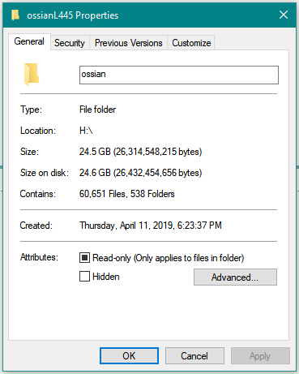
Data Preprocessing
Extracting Turkic_TTS’ data increased its size by a factor of 8
3GB -> 24GB
Both text and audio from Chuvash-language news clips
Steps:
Remove trailing ends from files (where silence was most common)
Segment audio files and pair with transcriptions
Match audio and text by renaming files
Notes:
Having many small clips of sentences is conducive to neural net training

Slide 8
Training Ossian
Took a few hours
Trained on Ubuntu 18.04 in an 8-core virtual machine with 8GB of RAM
Big Red II ambitions
Notes:
Talk about Big Red II obstacles

Slide 9
eSpeakNG
Formant synthesis
English & Spanish TTS work perfectly
Unable to test Chuvash due to corrupted installation of custom repo
Tested with sudo apt-get install espeak-ng (package manager)

Slide 10
Model Evaluation & Results
Ossian produced good-sounding Chuvash from Apertium text corpora samples
LPCNet, given the correct type of data, would’ve likely worked just as well
Unable to test eSpeak due to compilation and installation issues

Slide 11

Examples
“Ытти чӗлхесемпе пӗрлех ку хатӗрте чӑваш чӗлхи валли те вырӑн тупӑннӑ”
From apertium_chv corpus (/texts/cvorg-commonvoice.txt, line 2)
“Dante was here”
English (United States)
“Dante estaba aquí”
Spanish (Latin American)
Notes:
Classic graffiti

Slide 12
Future
Get more than one neural-net based system working
Implement Chuvash in eSpeak-NG to have a non-NN point of comparison

Slide 13
Special Thanks
Harry Zhang
Notes:
Harry Zhang: for his advice on audio preprocessing and work on implementing Chuvash to the eSpeak library
Viewers: This presentation was made possible in part by viewers like you. Thank you.

Slide 14
Special Thanks
Harry Zhang
And viewers like you. Thank you.
Notes:
Harry Zhang: for his advice on audio preprocessing and work on implementing Chuvash to the eSpeak library
Viewers: This presentation was made possible in part by viewers like you. Thank you.

Slide 15
References
Russian Bureau of Statistics: Владение Языками Населением Российской Федерации [Population of the Russian Federation by Languages]
http://www.gks.ru/free_doc/new_site/perepis2010/croc/Documents/Vol4/pub-04-05.pdf
Wikipedia: Speech Synthesis
https://en.wikipedia.org/wiki/Speech_synthesis
Wikipedia: Chuvash Language
https://en.wikipedia.org/wiki/Chuvash_language

Slide 16
Fin

